Slide 1
From Classroom to Corporate: Agile, Software Testing & Automation
Sai Kumar

Slide 2
Traditional Software Development Methodology
Traditional software development methodologies are based on pre-organized phases/stages
Req. Analysis -> Design -> Dev -> Testing -> Maintenance
Here the flow of development is unidirectional.
Traditional approaches are suited when requirements are well understood.
Traditional development methodologies are suitable only when the requirements are precise i.e., when the customer knows exactly what they want and can confidently say that there wont be any major changes in scope throughout the project development.
What if customer doesn’t know full requirements?
What if customer want to add new requirement(s)?
What if customer want to change in requirement?
The answer is adopt Agile Software Engineering Process/Model

Slide 3
Agenda for (3 days)
How Agile works - As a student, study Agile process
Agile way of testing - As a student, learn Agile testing
Software Testing types - As a student, understand Software Testing types
Unit testing framework - As a student, practice unit testing examples
API testing - As a student, perform API testing.
Web Automation - As a student, automate user interactions.

Slide 4
Agile process(model) in Software Engineering
What is Agile?
Agile is a software development approach where products are built incrementally and iteratively.
Instead of one big delivery at the end, Agile delivers small, usable pieces frequently.
Agile focuses on:
Customer collaboration
Rapid delivery of working software
Flexibility to change requirements
Continuous improvement
Agile is a philosophy/mindset/Concept. The are frameworks that implement Agile include:
Scrum
Kanban
SAFe etc.

Slide 5
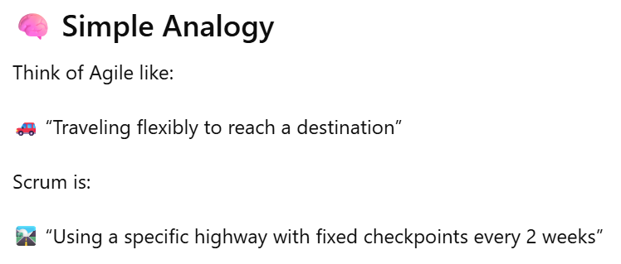
Agile process(model) in Software Engineering
Scrum is a lightweight Agile framework used to manage and deliver products in fixed time-boxed iterations called Sprints (2–4 weeks).
Scrum Structure
Roles
Product Owner
Scrum Master
Development Team
QA Team
Events
Sprint Planning
Daily Stand-up
Sprint Review
Sprint Retrospective
Artifacts
Product Backlog
Sprint Backlog
Increment

Slide 6
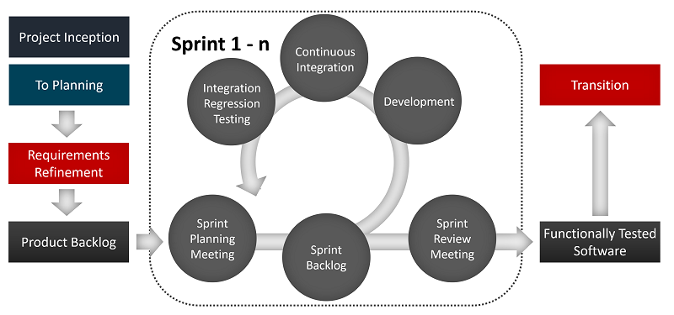
Agile Software Engineering Process
During project inception, BA/Customer split the functional requirements into User Stories.
The Scrum Master or Product owner organizes these User Stories and segregates them into different Sprints.
In general, Sprint contains few User Stories to be delivered in 2-4 weeks, based on the complexity of user stories.
Once the Sprint planning is done, the selected User Stories are once again split into Tasks so that the developer can have a clear roadmap to deliver quality output.
At the end of each Sprint, the customer gets a chance to review and predict the final outcome and can propose changes if any.

Slide 7
Agile process in Software Engineering
1️⃣ Scrum Workflow – Product Development (Most Common)
Scenario: Developing an E-commerce web application
Step-by-Step Workflow
1. Product Backlog Creation
Product Owner collects requirements:
User login
Product search
Add to cart
Payment integration
Backlog item example:
As a user, I want to search products so that I can find items quickly. (UI-API-Testing(Manual&Automation)
Books example - https://demoqa.com/
2. Sprint Planning (2-Week Sprint)
Scrum Master selects items from backlog
Planning Poker to estimate Story Points
Breaks into tasks:
UI design
API development
Database schema
Test Plan
3. Sprint Execution
Developers code features
Testers validate functionality
Daily Stand-up (15 mins):
What I did yesterday
What I’ll do today
Any blockers?
4. Sprint Review
Demo working features to stakeholders:
Search
Product listing
Feedback collected (e.g., “Add price filter”)
5. Sprint Retrospective
What went well?
What didn’t?
Improvements for next sprint?
6. Increment Delivery
Deploy to staging or production
📌 Outcome: Working product every sprint

Slide 8
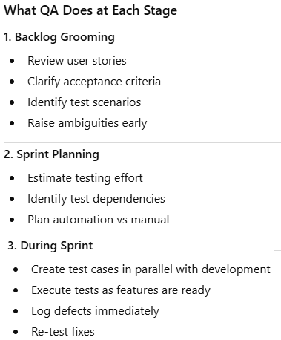
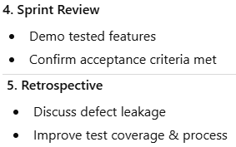
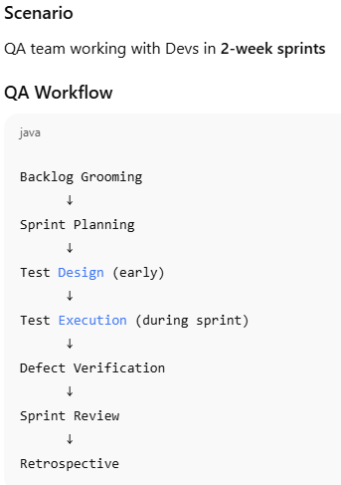
Agile process models in Software Engineering – QA Workflow

Slide 9
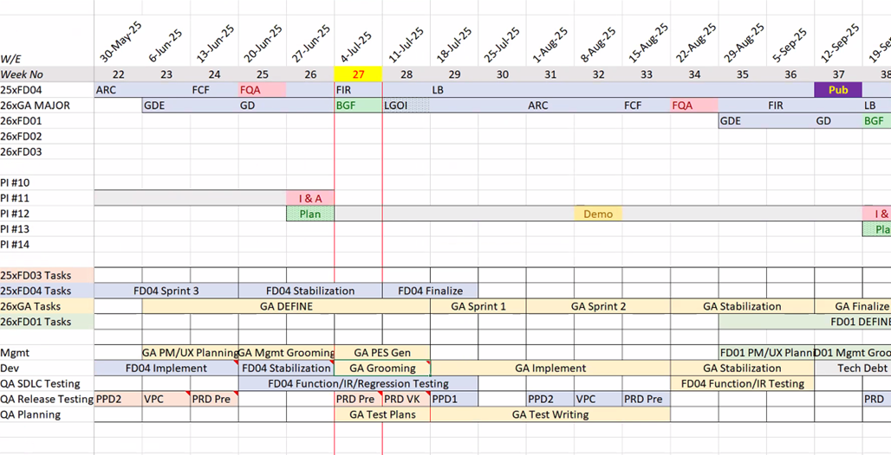
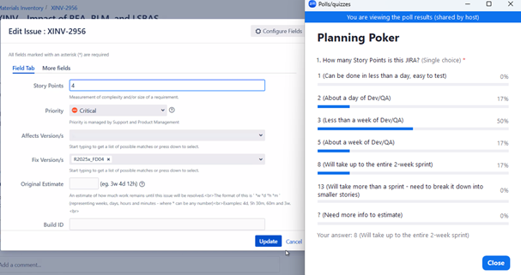
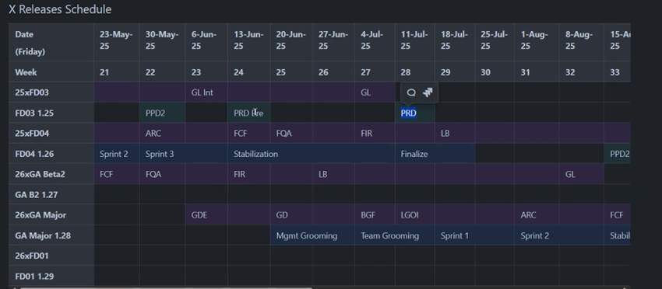
Agile process models in Software Engineering – Planning Board
GDE: Go Define Enterprise
GD: Go Define
LGOI: Last GO Implement
ARC: Affordability Resolution Cutoff
FCF: Function Content Frozen(code delivered)
FQA: First Quality Assessment
FIR: Full Industrialization Replay
LB: Last Build

Slide 10
Agile process models in Software Engineering
2️⃣ SAFe (Scaled Agile) – Large Enterprise Projects
Scenario: Developing a telecom billing platform with 100+ developers
Workflow
1. Program Increment (PI) Planning
8–12 weeks
Multiple teams align on objectives
2. Team-Level Scrum
Each team runs its own sprints
3. System Demos
Integrated solution demoed regularly
4. Inspect & Adapt
Large-scale retrospective
📌 Outcome: Coordination across many teams
3️⃣ Agile + DevOps Workflow (Modern Setup)
Scenario: Cloud-based SaaS product
Workflow
Plan → Code → Build → Test → Deploy → Monitor → Feedback
CI/CD pipelines
Automated testing
Monitoring via logs & alerts
Feedback feeds next sprint
📌 Outcome: Faster releases, high reliability
4️⃣ Kanban Workflow – Production Support / Maintenance
Scenario: Handling bug fixes & change requests for a live application
Workflow: Kanban Board Example
Backlog → To Do → In Progress → Testing → Done
1. Ticket Creation
Bugs reported via Jira:
Payment failure
Login timeout
UI alignment issues
2. WIP Limits Applied
Only 3 tasks allowed in “In Progress”
Prevents overload
3. Continuous Flow
Developer picks next highest priority task
No sprints
Task moves across the board
4. Continuous Delivery
Fix deployed immediately after testing
📌 Outcome: Faster response time, better flow
📌 Real-world use: DevOps teams, L2/L3 support

Slide 11
A Functional Delivery in Agile Software Engineering Process
Planning, Defining : https://bio-rdjira.dsone.3ds.com/browse/XINV-1619
https://bio-rdjira.dsone.3ds.com/browse/XINV-635
Function: Defined in dsxRD tool → equivalent EPIC in Jira → User Stories (1,2,3…)
Designing
User Story: Status – In Progress
Dev & QA
Understand the requirement of the User Story
Write Acceptance Criteria (AC) / Exit Criteria
Developers: Dev tasks
Grooming
UI/UX
API
QA: Testing tasks
Test Plan
Test Tasks
Test Case Writing
Building (Developing)
Code creation/changes
Merge/Integrate with repository
Ref: https://bio-rdjira.dsone.3ds.com/browse/XINV-1649
Pipeline created
Tested(Unit Testing), build generated(Green)
User Story
Status: Under Test
Testing (in Integration build)
Grab the build, install and Start testing
Deployment and Maintenance (After building and testing all the US of release)
https://bio-rdjira.dsone.3ds.com/browse/XINV-1414

Slide 12
A Functional Use Case-2 Explained
Dispense Quantity
Functional Specification: Requirements, Technical Analysis etc.
Epic: https://bio-rdjira.dsone.3ds.com/browse/XINV-1587
User Story: https://bio-rdjira.dsone.3ds.com/browse/XINV-1657
Test Case: https://dsxdev-online.dsone.3ds.com/enovia/common/emxNavigator.jsp?physicalId=7D5CB056E91F1200670D1DA000052646
Test Execution against Target build(release) – Replay

Slide 13
🧩 Scrum Board – Learning Sprint
🟣 EPIC
Understand Agile Software Engineering Practice to become Industry-Ready
📌 SPRINT GOAL
Learn Agile software development practice so that I can implement it in my projects.
📝 Product Backlog | 🚀 Sprint Backlog(User Story) | 🔄 In Progress (Tasks) | ✅ Done
📌 Learn how Agile works | As a student, study Agile process | Task - Understanding Agile process | ✔ Agile process understood
📌 Learn Agile way of testing | As a student, learn Agile testing | Task - Understanding Agile Testing | ✔ Agile Testing understood
📌 Learn Software Testing types | As a student, understand Software Testing types | Task - Understanding Software Testing types | 📌 Testing types understood
📌 Learn Unit testing framework | As a student, practice unit testing examples | Task - Writing unit test examples | 📌 Unit testing understood
📌 Learn API testing | As a student, perform API testing. | Task - Sending API requests | 📌 API testing understood
📌 Learn Web Automation | As a student, automate user interactions. | Task - Automating user interactions | 📌 Web automation understood

Slide 14
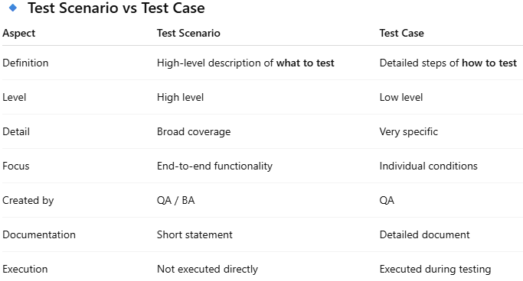
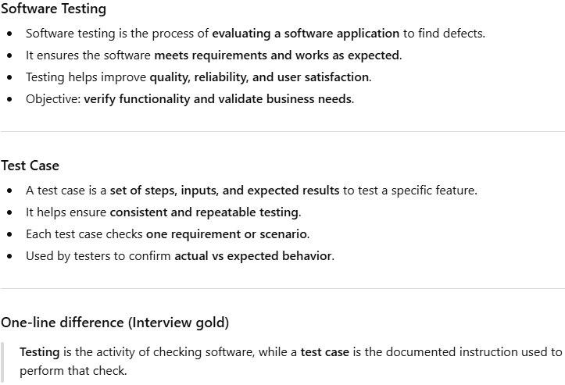
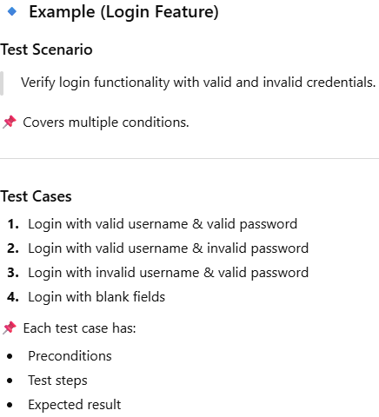
Software Testing

Slide 15
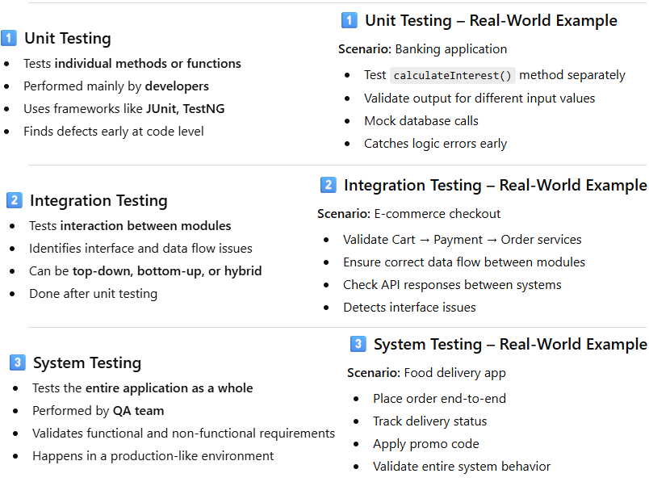
Software Testing Types

Slide 16
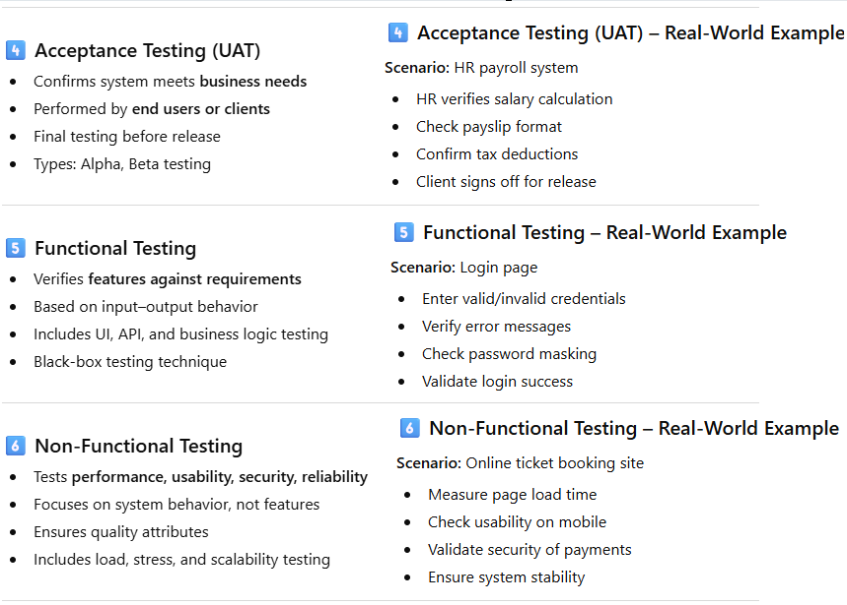
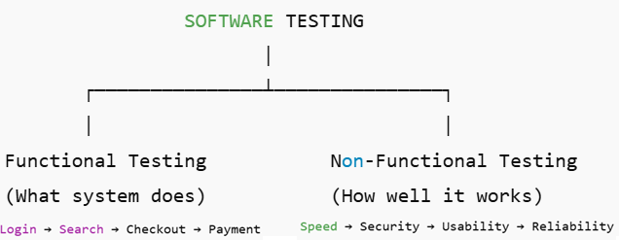
Software Testing Types

Slide 17
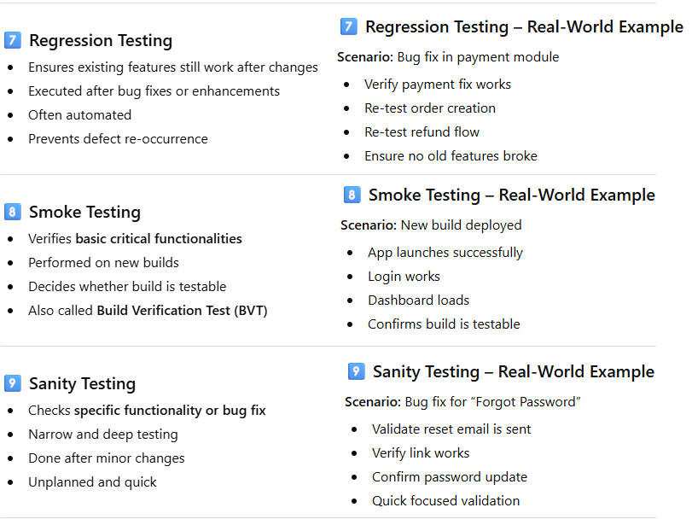
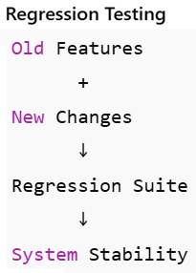
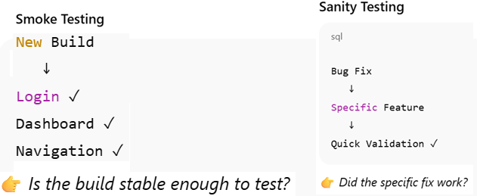
Software Testing Types

Slide 18
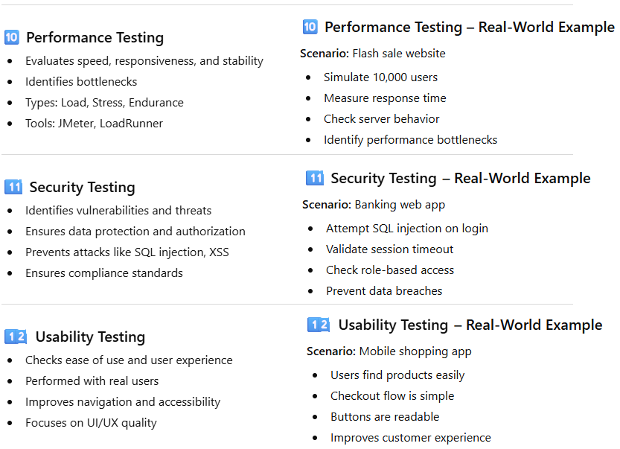
Software Testing Types

Slide 19
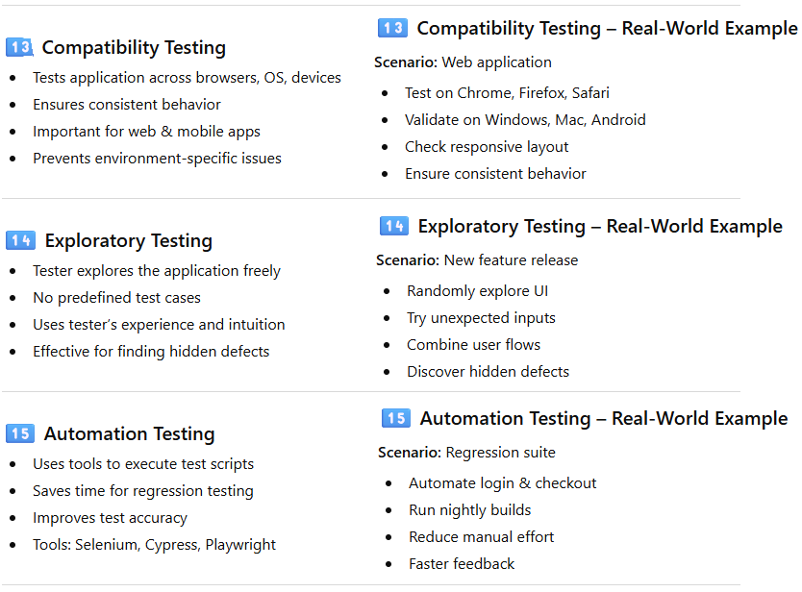
Software Testing Types

Slide 20
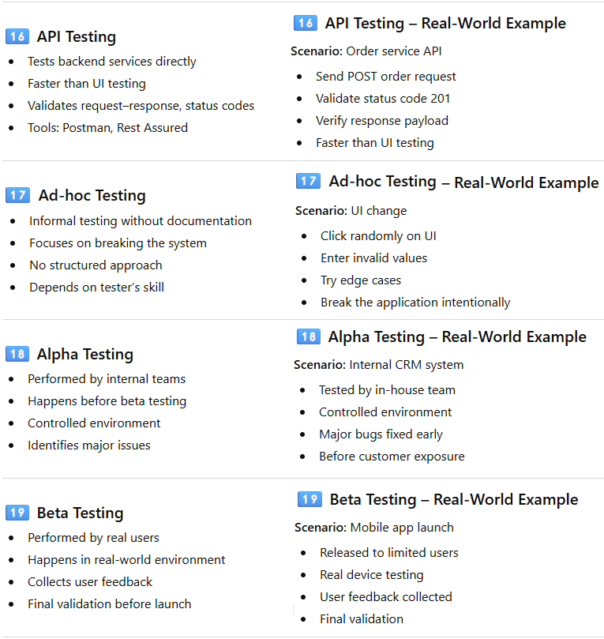
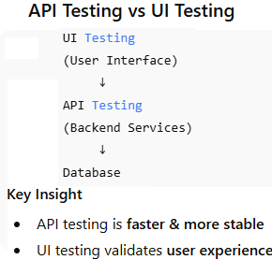
Software Testing Types

Slide 21
🧩 Scrum Board – Learning Sprint
🟣 EPIC
Understand Agile Software Engineering Practice to become Industry-Ready
📌 SPRINT GOAL
Learn Agile software development practice so that I can implement it in my projects.
📝 Product Backlog | 🚀 Sprint Backlog(User Story) | 🔄 In Progress (Tasks) | ✅ Done
📌 Learn how Agile works | As a student, study Agile process | Task - Understanding Agile process | ✔ Agile process understood
📌 Learn Agile way of testing | As a student, learn Agile testing | Task - Understanding Agile Testing | ✔ Agile Testing understood
📌 Learn Software Testing types | As a student, understand Software Testing types | Task - Understanding Software Testing types | ✔ Testing types understood
📌 Learn Unit testing framework | As a student, practice unit testing examples | Task - Writing unit test examples | 📌 Unit testing understood
📌 Learn API testing | As a student, perform API testing. | Task - Sending API requests | 📌 API testing understood
📌 Learn Web Automation | As a student, automate user interactions. | Task - Automating user interactions | 📌 Web automation understood

